Slide 1



Comparing performance of 3 models to predict wine quality based on physicochemical properties

Slide 2


Content
Introduction
Logistic regression model
Preprocessing
Training
Evaluation
Neural networks
Neural network structure
Compile and train
Evaluation
Random Forest Classifier
Training
Evaluation
Conclusion

Slide 3
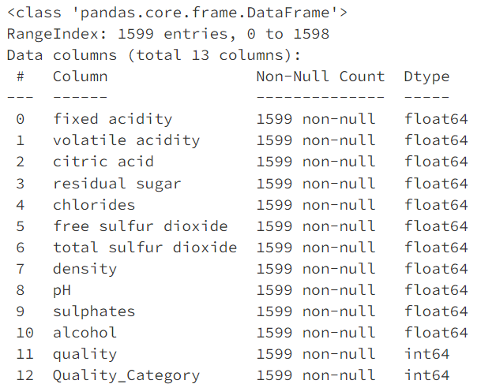
The project aims to classify wine quality based on various physicochemical features
The dataset contains 1,599 samples of red wine, each characterized by 11 features such as fixed acidity, volatile acidity, citric acid, residual sugar, and so on.

Slide 4
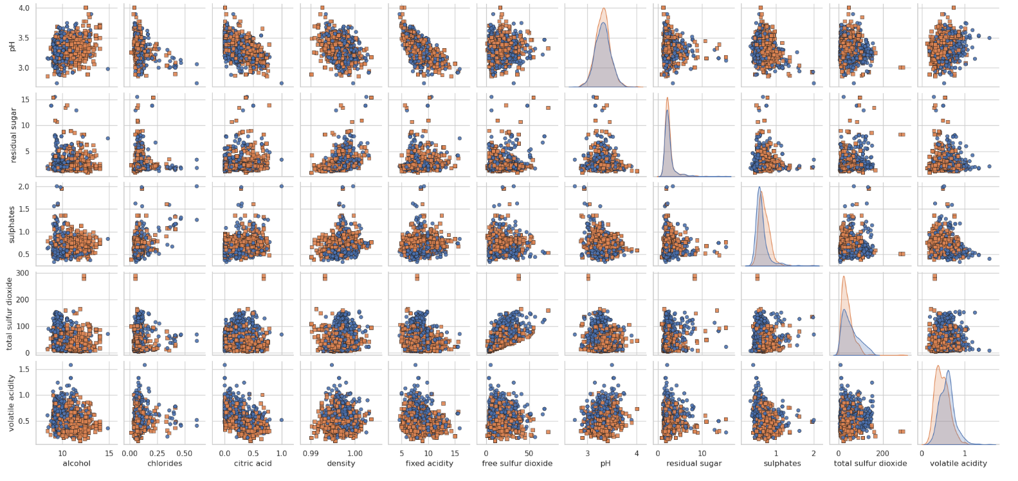
We then performed exploratory data analysis (EDA) to understand the distribution of each feature and its relationship with the target variable, wine quality.
It is possible to observe that considering only one pair of attributes it is quite complicated to discern between low vs high quality wine.
We applied PCA and observed that with 9 parameters we would be able to keep 95% of the variance.

Slide 5
Logistic Regression Model

Slide 6
Logistic Regression Model
Preprocessing
Neural Networks
NN Structure
Random Forest Classifier
Training
Training
Compile & Train
Evaluation
Evaluation
Evaluation
Missing values QA
Binary classification
Using map method, we transformed the quality scores into two categories: 'low' for scores 3-5 and 'high' for scores 6-8
Standard Scaler
Train-test split
RandomOverSampler

Slide 7
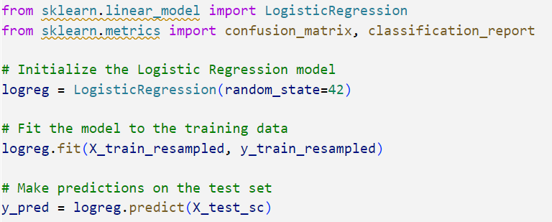
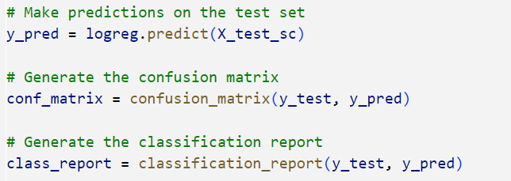
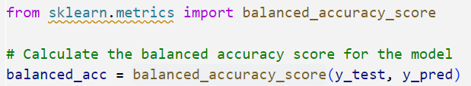
Logistic Regression Model
Preprocessing
Neural Networks
NN Structure
Random Forest Classifier
Training
Training
Compile & Train
Evaluation
Evaluation
Evaluation
Training
Evaluation
Balanced accuracy score of 75%:
The model correctly identified 69% of the good quality wine
The model correctly identified 81% of the low-quality wine

Slide 8
Neural Networks

Slide 9
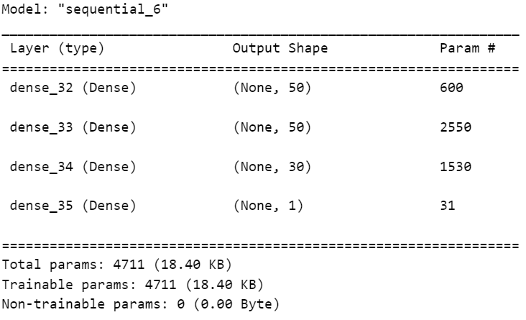
Logistic Regression Model
Preprocessing
Neural Networks
NN Structure
Random Forest Classifier
Training
Training
Compile & Train
Evaluation
Evaluation
Evaluation
3 Layers
1st
hidden layer
2nd
hidden layer
3rd
hidden layer
50 Neurons
Relu
50 Neurons
Relu
30 Neurons
Relu
Output
layer
1 Neuron
Sigmoid

Slide 10
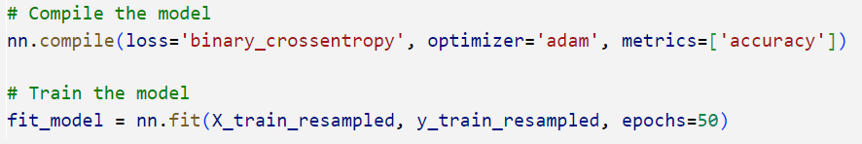
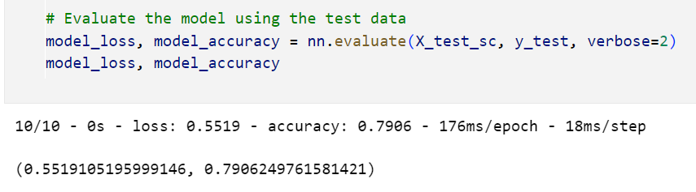
Logistic Regression Model
Preprocessing
Neural Networks
NN Structure
Random Forest Classifier
Training
Training
Compile & Train
Evaluation
Evaluation
Evaluation
Compile &Train using 50 epochs
Performance

Slide 11
Random Forest Classifier

Slide 12
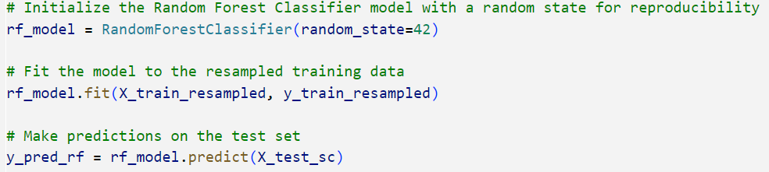
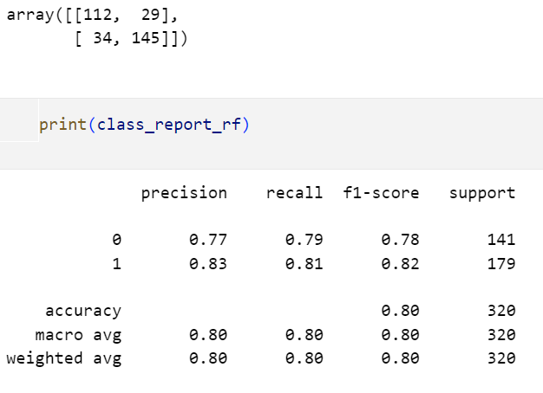
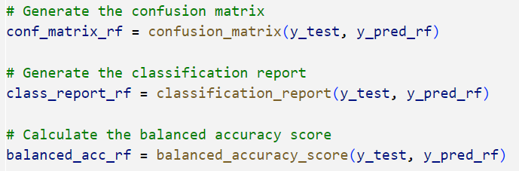
Logistic Regression Model
Preprocessing
Neural Networks
NN Structure
Random Forest Classifier
Training
Training
Compile & Train
Evaluation
Evaluation
Evaluation
Compile &Train using 50 epochs
Performance

Slide 13
Conclusions

Slide 14
Conclusions
The random forest classifier was the model with highest balanced accuracy score. Using this model it was possible to predict wine quality based on physicochemical features in 80% of the cases.
Increasing the number of neurons, the amount of hidden layers and trying different activation functions had an impact of only 2 to 3% increase in accuracy. After doing so accuracy increased from 77 to 80%.
The regression model was the one with lowest balanced accuracy score: 75%.

Slide 15
Next Steps
"Free Sulfur Dioxide" and "Total Sulfur Dioxide" have relatively low contributions across the principal components. Removing these and re-running the models could provide insights into how these features impact accuracy.
PCA components was assessed, and it was possible to observe that both parameters were not considered significantly in any of the principal components.
Assess Z score per parameter, remove outliers using that methodology. Re-run models after doing so to measure the impact in accuracy.
Future work could involve hyperparameter tuning and experimenting with other classification algorithms to further improve the model's performance.

Slide 16
Thank You

